Slide 1
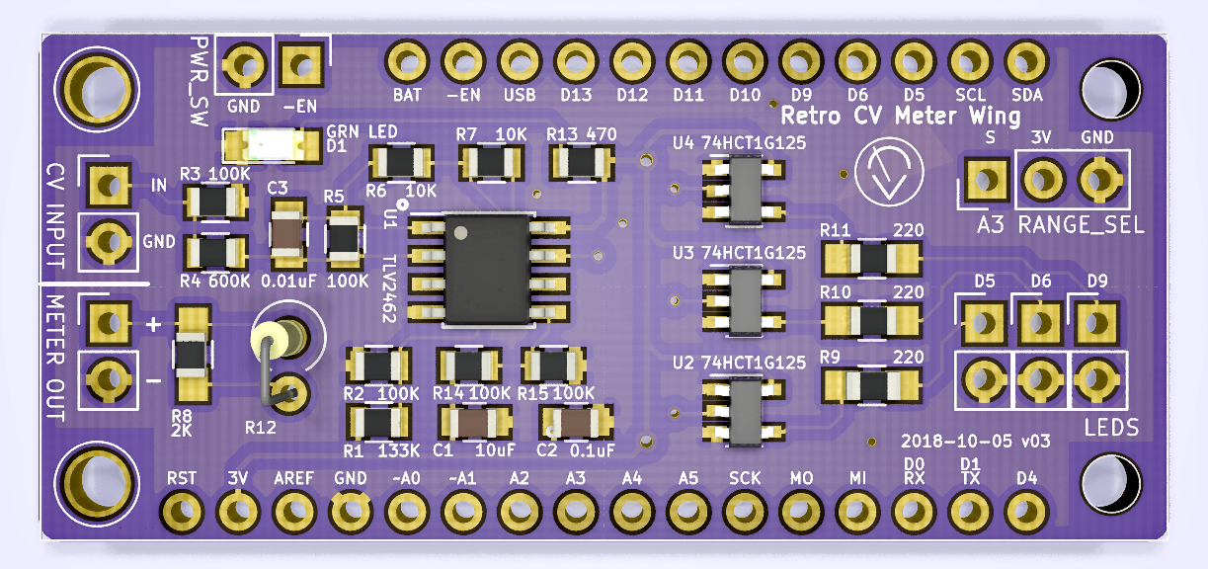
-EN connect to GND to disable power
also disables Feather MCU power
LED glows when power is enabled
3V 3.3 volt power from Feather MCU
GND ground connection to/from Feather MCU

Slide 2
D5 Digital output to LED buffer
D6 Digital output to LED buffer
D9 Digital output to LED buffer
A0 DAC output to meter via R8 or R12
A2 Analog input from input signal processing stage
A3 Analog input from range selection potentiometer

Slide 3
D10 digital output to piezo speaker
LEDs:
High-current buffered outputs for LEDs; 25mA max
(connect anode to upper pin, cathode to lower pin)
Recommended that LED current and brightness be
controlled by PWM instead of adjusting R9-R11 values.

Slide 4
RANGE_SEL:
Range selection potentiometer connection
(potentiometer wiper attached to S pin)
METER OUT:
Analog output to meter (note polarity)
R8 and R12:
Series resistance matched to meter full-scale current at +3.3volts

Slide 5
CV INPUT:
-10 volt to +10 volt control voltage input to signal processing stage

